Slide 1
Analysis and Prediction of Readmissions at a Large University Medical Center
Dr. Shant Ayanian, MD, MS, FACP
Dr. Nima Zahadat, Ph.D.

Slide 2
Introduction
Readmissions are defined as patients presenting back to the hospital after an index admission within a prespecified time.
Most metrics depend on the 30 day readmission rate of a hospital.
Centers for Medicare and Medicaid Services and other payors follow readmission rates of hospitals closely and may withhold or reduce payments.
Readmissions are indicators of potentially unsafe patient care
Reduction of readmissions are important for patients, hospitals and payors

Slide 3
Introduction
There has been studies done to try to predict which patients are at risk for readmissions.
Large studies had identified generalized algorithms which predict readmissions: eg LACE readmission tool or HOSPITAL tool.
Both tools have good accuracy but lack high specificity.
They do not take into account hospital specific factors which may affect readmissions.

Slide 4
Motivation
A customizable readmission predictor model would be of paramount importance.
There have been deep learning models which have attempted to do this and have achieved a specificity of 30%.
There has not been any attempts for a random forest classifier to predict readmissions.
There are no studies discussing the use of ARMA models

Slide 5
Data
The data was extracted by using MIDAS, a proprietary software widely used in hospitals to track quality events and quality data.
It is a complex data of more than 250 features, spanning a total of 10 years,, from 2008 to 2018, with 200000 patients.
After cleaning and removing NAs, a total of 183 features and 154K patients were included in the final study.
Only features available for all years were years.
NA values for these features were imputed from mean

Slide 6
Exploratory Data analysis
Feature engineering was necessary as readmissions were not part of the data.
Using their unique identifier, and unique encounter identifier, patients who returned to same facility within 30 days were marked as readmissions.
The total number of readmissions was also calculated for every day.
In addition multiple other calculated fields were added pertaining to physician characteristics.
Further visualization of different features was done on Tableau

Slide 7
Exploratory data analysis
Feature engineering was also applied to classify patient’s illness.
The Elixhauser disease severity index has been used to transform the ICD 10 into 20 buckets of common illness
It also was used to assign a weighted disease severity index.
A procedure count was conducted as well as a consult count

Slide 8
MEthodology
Three different analytical approaches used:
Logistic regression with elastic net gradient descent
Random Forest Classifier
Autoregressive moving average (ARMA) model

Slide 9
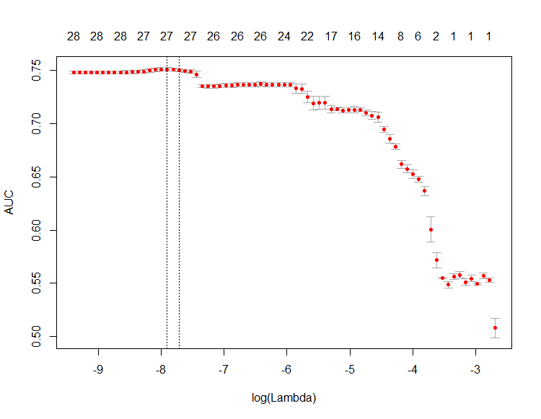
Elastic net models
Model | Accuracy | Specificity | RMSE
Model1 | 0.921 | 0.15 | 1.07
Model2 | 0.924 | 0.15 | 0.0771
Model3 | 0.916 | 0.123 | 0.071

Slide 10
Features selected
Admitting_Source_OUTPATIENT_CLINIC | Facility_DC_Disposition_DISCH_TO_HOSPICE_HOME
Admitting_Source_TRANS_SKILLED_NURSING_FACILITY | Discharge_APR_DRG_MDC16
Admitting_Loc_HOSP_ER_HOLDING | Discharge_APR_DRG_MDC18
Admitting_Source_ROUTINE_IP_ADMISSION__UNSCH | Discharge_APR_DRG_MDC23
Admitting_Loc_GWU_PACU | Discharge_APR_DRG_MDC11
Admitting_Loc_GWU_5_SO_ONCOLOGY | CDB_APR_DRG_Acute_Care_Expected_Mortality
Admitting_Service_Code_NEU | DRG_MDC_NO_17
Principal_Payer_H_S_C_S_N__MCAID_HMO | CDB_APR_DRG_All_Inpatient_Expected_Mortality
Principal_Payer_AMERIHEALTH_MCAID | rheumd
Principal_Payer_MEDICAID | solidtum
Principal_Payer_NON_CONTRCTD_HMO_PPO | lymph
Principal_Payer_Type_SELF_PAY_ADMIT | diabc
Principal_Payer_MEDICARE_PT_B_IP | pvd
Principal_Payer_AMERIHEALTH_ALLNCE | metacanc

Slide 11
Random Forest MOdel
Features | MeanDecreaseGini
CDB_APR_DRG_All_Inpatient_Expected_Mortality | 1056.624
Discharge_APR_DRG_MDC23 | 918.1059
CDB_APR_DRG_Acute_Care_Expected_Mortality | 712.5953
Admitting_Source_ROUTINE_IP_ADMISSION__UNSCHEDULED_ | 139.4197
Discharge_APR_DRG_MDC18 | 111.394
DRG_MDC_NO_17 | 109.4892
diabc | 95.33324
Admitting_Loc_GWU_5_SO_ONCOLOGY | 93.28339
Admitting_Loc_GWU_PACU | 81.13076
Principal_Payer_MEDICAID | 67.72274
solidtum | 65.01218
lymph | 61.86407
metacanc | 60.12244
pvd | 55.80766
Principal_Payer_AMERIHEALTH_MCAID | 49.59602
Discharge_APR_DRG_MDC16 | 46.64945
Admitting_Service_Code_NEU | 45.87765
rheumd | 43.13089
Discharge_APR_DRG_MDC11 | 35.91112
Principal_Payer_MEDICARE_PT_B_IP | 30.36313
Principal_Payer_AMERIHEALTH_ALLNCE | 22.22456
Principal_Payer_Type_SELF_PAY_ADMIT | 21.51761
Facility_DC_Disposition_DISCH_TO_HOSPICE_HOME__CONTINUOUS_CARE_ | 15.36546
Principal_Payer_H_S_C_S_N__MCAID_HMO | 12.46622
Admitting_Source_OUTPATIENT_CLINIC | 11.67475
Admitting_Loc_HOSP_ER_HOLDING | 9.309824
Principal_Payer_NON_CONTRCTD_HMO_PPO | 7.15871
Admitting_Source_TRANS_SKILLED_NURSING_FACILITY | 3.829835
Confusion Matrix and Statistics
Reference
Prediction 0 1
0 28123 2344
1 158 364
Accuracy : 0.9193
95% CI : (0.9162, 0.9223)
No Information Rate : 0.9126
P-Value [Acc > NIR] : 1.459e-05
Kappa : 0.2029
Mcnemar's Test P-Value : < 2.2e-16
Sensitivity : 0.9944
Specificity : 0.1344
Pos Pred Value : 0.9231
Neg Pred Value : 0.6973
Prevalence : 0.9126
Detection Rate : 0.9075
Detection Prevalence : 0.9832
Balanced Accuracy : 0.5644

Slide 12
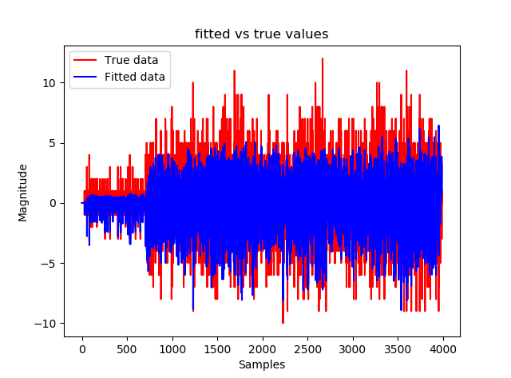
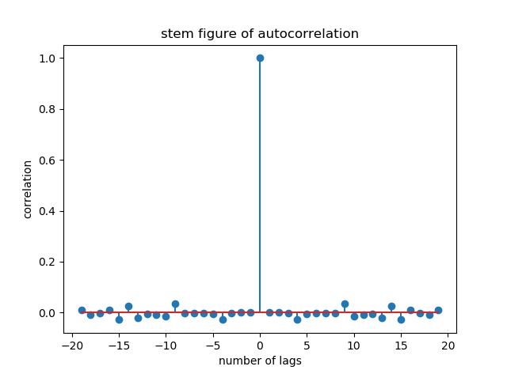
ARMA Model

Slide 13
analysis
All logistic models had excellent accuracy, but poor specificity.
Random forest classifier has a similar specificity
Models are helpful as they have the potential to decrease readmissions by half
They are customizable and easy to implement
ARMA model could be useful in evaluating factors affecting total readmissions

Slide 14
Future directions
Prospective study to evaluate model implementability as well as specificity.
Address factors identified in regression analysis as potential drivers to readmissions
Construct an LSTM model to test its accuracy in this dataset
Address a differential approach to an ARMA model for readmission number prediction.

